Slide 1
AI Powered ML Solution for Customer Retention and Loan Decision Optimized for Banking Sector.
GUIDE DETAILS:
Mrs. J. KIRUPAVATHY.,
Assistant Professor
TEAM MEMBERS,
DEEPIGHA SHRI CM(113321243009)
MAHAPAVITHRA R(113321243021)
SAKTHIPRIYA P(1133221243044)

Slide 2
OBJECTIVE
Develop an AI-powered web application that integrates customer churn prediction and loan decision-making into a single, unified banking platform.
Implement ML models—Extra Trees Classifier for churn (~93% accuracy) and Random Forest Classifier for loan approval (~91.81% accuracy).
Integrate an AI chatbot with NLP to support real-time employee interaction .
Automate decision processes to reduce manual workload, minimize errors, and enhance operational efficiency and customer satisfaction.

Slide 3
ABSTRACT
This project proposes a unified AI-based solution to address inefficiencies in traditional banking, combining churn prediction and loan decision automation.
Machine learning models are used to accurately predict customer behavior and automate loan approvals, improving decision quality.
An AI-powered NLP chatbot is integrated to allow real-time interaction, simplifying access to insights for bank employees.
The system supports digital transformation in banking by increasing operational efficiency, reducing manual work and enhancing customer service.

Slide 4
EXISTING SYSTEM
Churn prediction and loan approvals are handled using separate systems, increasing complexity and reducing efficiency.
Manual data entry and decision-making lead to slow operations and a high risk of human errors.
Lack of AI-based analytics means at-risk customers go unnoticed, affecting retention rates.
Limited or no automation, resulting in increased workload and poor scalability.

Slide 5
PROPOSED SYSTEM
A unified platform integrates churn and loan prediction, offering all results in one dashboard.
Real-time predictions using ML models with high accuracy reduce decision-making time.
An AI-powered chatbot improves communication and reduces dependency on manual support.
Automated processes reduce human error and manual workload significantly.
The system is web-based and role-specific, accessible to bank employees.

Slide 6
LITERATURE SURVEY
Vijay Kumar et al. (2024) used logistic regression and decision trees for loan default prediction, reducing bad loans.
Victor Chang et al. (2024) found that deep learning models like LSTM outperform traditional ML models in credit risk prediction.
Vikas Kumar et al. (2023) developed a hybrid ensemble model for loan risk with improved accuracy and reliability.
Vahid Sinap (2024) showed that Random Forest performs best among classifiers for loan approval automation.
Neeraj Kripalani (2024) proposed a churn prediction model using customer behavior and sentiment analysis for proactive retention.

Slide 7
ARCHITECTURE DIAGRAM
INPUT
PROCESS
OUTPUT
Customer Transaction History
ML Churn Prediction Model
Churn Risk Scores & Retention Recommendations
Demographic Data
Automated Loan Approval System
Automated Loan Decisions & Risk Assessments
Loan Applications
Sentiment Analysis Engine
Personalized Customer Engagement Strategies
Customer Feedback

Slide 8
LIST OF MODULES
Data Preprocessing Module
Churn Prediction Module
Loan Eligibility Module
AI Chatbot Module
Dashboard &Interface Module
EMI Calculator Module
Authentication Module

Slide 9
MODULE DESCRIPTION
Data Preprocessing Module: Cleans and prepares data by handling missing values, outliers, and encoding, ensuring it’s ready for machine learning.
Churn Prediction Module: Uses Extra Trees Classifier to predict if a customer is likely to leave, helping banks take early retention steps.
Loan Approval Module: Uses Random Forest Classifier to automatically approve or reject loan applications based on customer data.

Slide 10
MODULE DESCRIPTION
AI Chatbot Module: Enables real-time employee interaction using NLP to answer queries about loans and customers.
Dashboard & Interface Module: Provides a simple web UI where employees can upload documents, see predictions, and interact with the system.
EMI Calculator Module: Helps users calculate their monthly loan repayments before applying.
Authentication Module: Ensures secure, role-based access for admins, employees, and customers.

Slide 11
CONCLUSION
The system successfully brings automation and intelligence into core banking operations.
It significantly improves accuracy, speed, and efficiency of loan decisions and customer retention efforts.
The platform’s modular design makes it flexible and scalable for future enhancements.
It enhances customer experience by providing fast, reliable, and personalized banking services.
Integration of AI and ML has made the solution practical, impactful, and aligned with real-world banking needs.

Slide 12
FUTURE ENHANCEMENT
Fraud Detection Module: Integrate anomaly detection to identify suspicious activity.
Advanced ML Models: Use LSTM, XGBoost, or deep learning to further improve accuracy.
Multilingual Chatbot: Enable support for regional languages to serve a broader audience.
Mobile App Version: Launch an Android/iOS version for enhanced accessibility.
Real-Time Data Handling: Use tools like Kafka or Spark Streaming for live predictions.

Slide 13
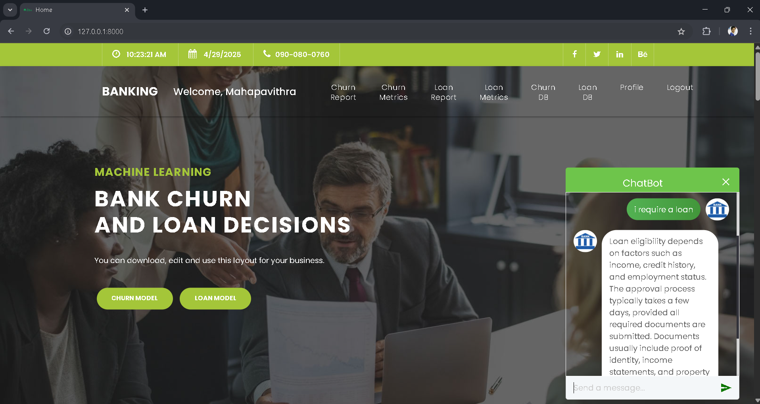
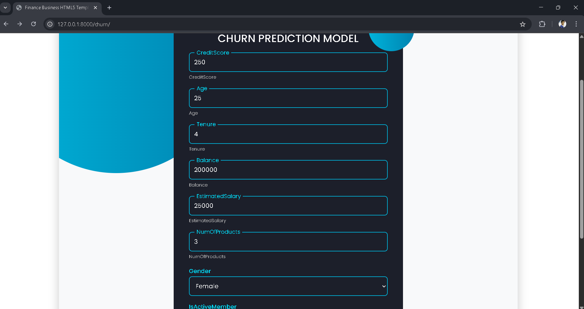
OUTPUT
FIG 1. Loan Chatbot Guidance
FIG 2. Entering Data for Churn Prediction

Slide 14
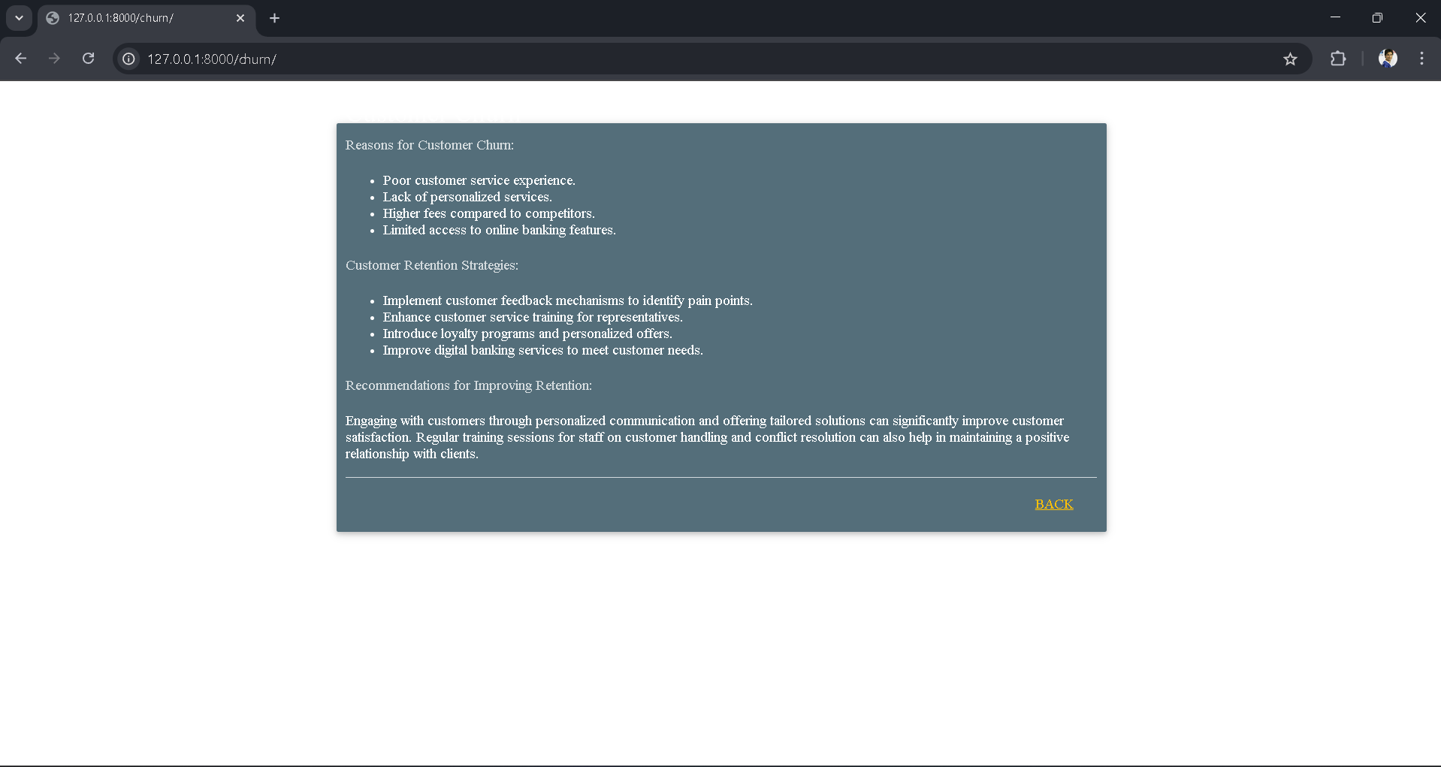
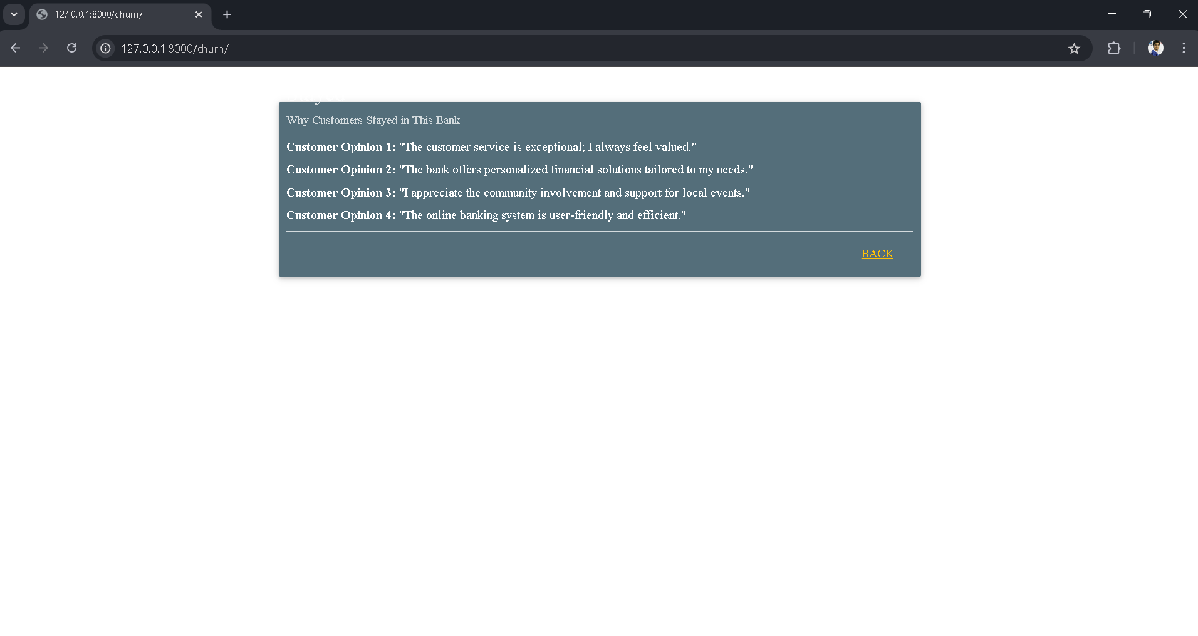
OUTPUT
FIG 3. Intention for churn
FIG 4. Positive Customer opinions

Slide 15
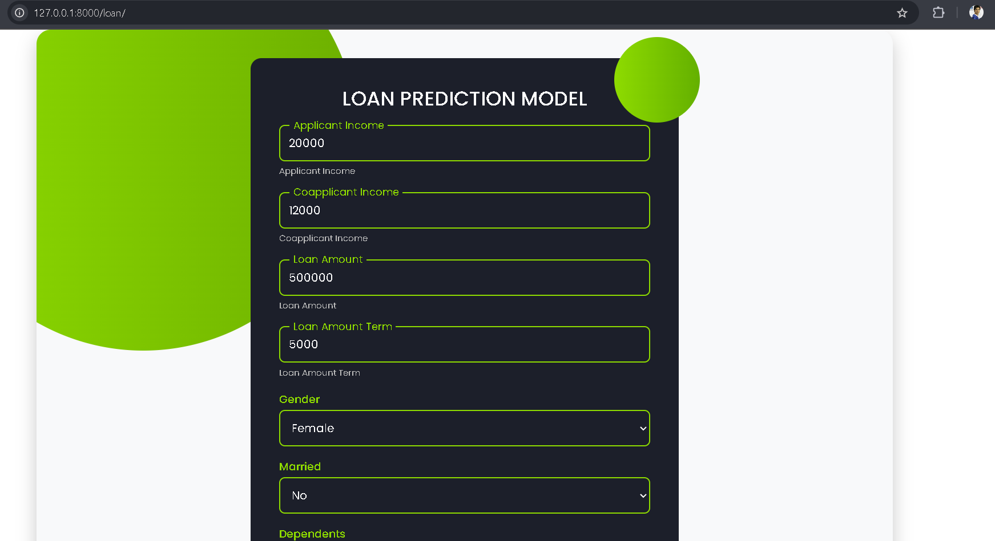
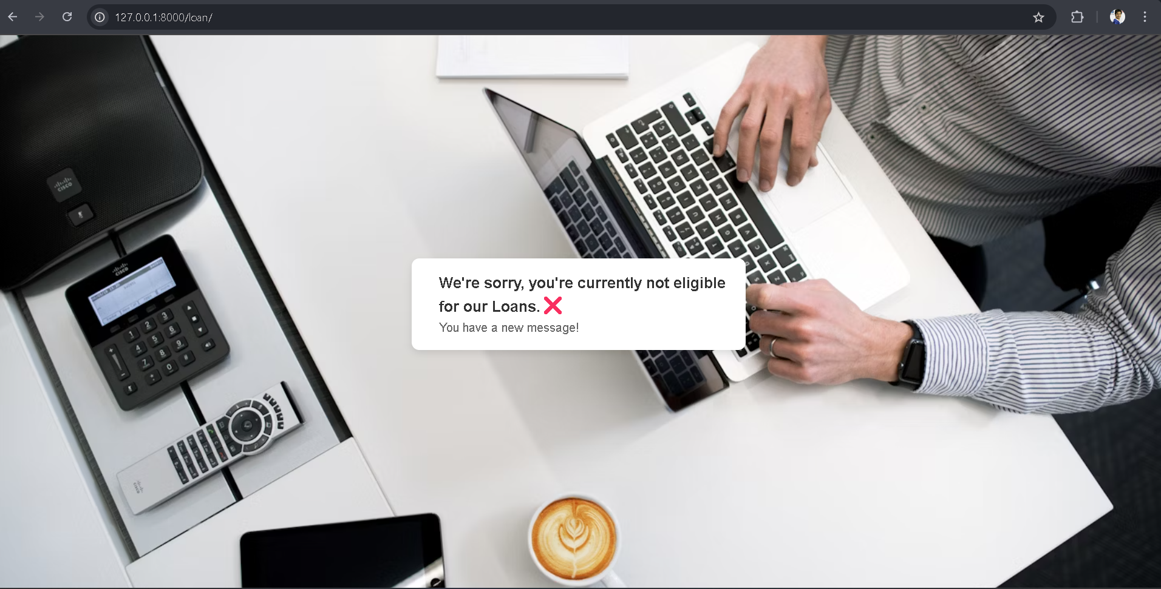
OUTPUT
FIG 5. Loan Prediction Model Input
FIG 6. Loan rejection alert

Slide 16

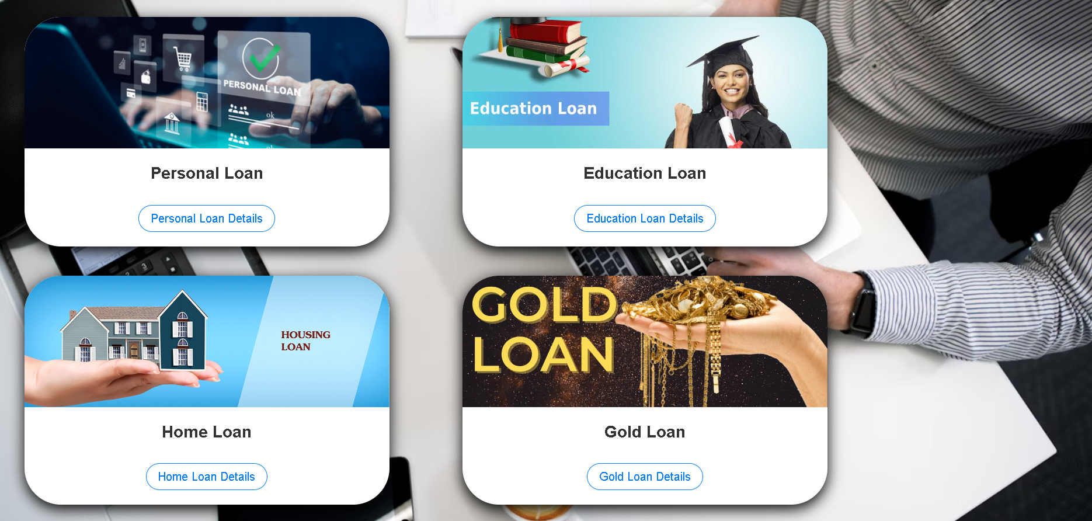
OUTPUT
FIG 7. Loan eligibility notification
FIG 8. Loan options

